Slide 1

Scala Spray Akka RESTful application
by Marta Doberschuetz

Slide 2

Project goals
to get familiar with Scala programming language
to get familiar with web service concept and a broad range of technologies
to get familiar with Actor paradigm
note the “get familar” as…

Slide 3


The project
is not about the language
it is about the concepts
The technologies:
REST Akka
Spray Slick
Curl Play!
Heroku
Notes:
So I am not an expert in Scala or any of the technologies, I simply got familiar with its concepts.

Slide 4

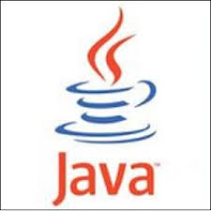

programs resemble
programs and they can seamlessly interact with code written in Java
- Scala shares most of the operators, data types, and control structures with Java and C#
Scala can interact with main platforms: Java and C#
Example1

Slide 5
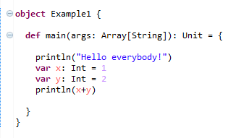
Example1.scala
Notes:
Java’s println method
Int same as int in Java, but capital letter
The difference is how you define variables in Scala x: Int instead of int x
def main starts a method definition – Scala’s syntax is more regular – all definitions start with a keyword
return type is Unit and not void like in Scala and is written after the function definition
Scala has class and object definitions
An object defines a class with a single instance – this is sometimes called a singleton object

Slide 6
OO and functional
Scala uses a pure object-oriented model:
every value is an object and
every operation is an invocation of a method
Scala is a functional language:
every function is a value
so we can pass a function as a parameter into another function
or return them as a result
Example2 & Example3
Notes:
Java is not a pure object-oriented language as it has primitive data types

Slide 7
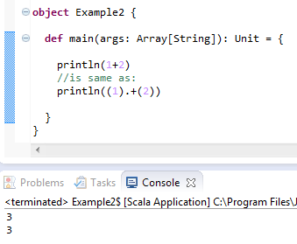
Example2.scala
Notes:
- because u invoke a + method on object which value is 1 and u pass a parameter 2
- remember - everything is an object in Scala

Slide 8
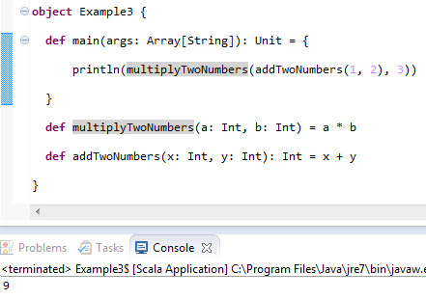
Example3.scala
Notes:
- CORRECT THIS EXAMPLE!!!

Slide 9
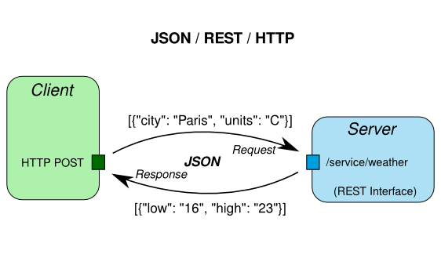
RESTful web service
Notes:
SOAP is a protocol specification for exchanging structured information in the implementation of Web Services
and REST is an architectural style
The idea for the project was to create a RESTful web service that would be hosted on a server (locally or on Heroku).
The service provides basic CRUD operations and a withdraw() and deposit() functions.
We can send a HTTP request in a JSON format and get a response back also in a JSON format.

Slide 10
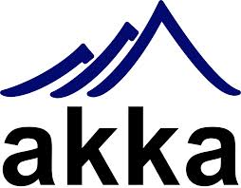

toolkit that allows to create concurrent applications
no race conditions or deadlocks
thread safety
Akka uses Actors
Notes:
Main problem with Java’s concurrency is that when running multiple threads the programmer has to decide what locks to put when on what data
It leads to race conditions - a situation where two different threads access the same data and update the value of that data without locking
It leads to deadlocks – when one threads is waiting for the other to give access to the data, they can be waiting forever…

Slide 11
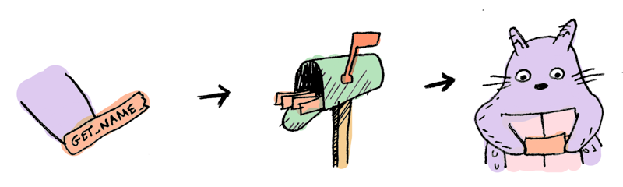
Actor paradigm
messages
mailboxes
Example5.scala
Notes:
An Actor is a thread-like entity that has a mailbox for receiving messages
the actor waits for a message to arrive to its mailbox
- concurrency is message-based and asynchronous
no mutable data is shared
In computer programming, asynchronous events are those occurring independently of the main program flow. Asynchronous actions are actions executed in a non-blocking scheme, allowing the main program flow to continue processing.

Slide 12
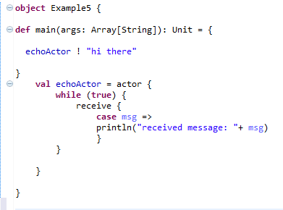
Example5.scala
Notes:
- Actors send messages to each other by using the “!” method
In the example above the actor receives a message by calling “receive”
- When an actor sends a message, it does not block, and when an actor receives a message, it is not interrupted.
The sent message waits in the receiving actor’s mailbox until the actor calls receive.
Note of “case” keyword, receive could have a few “case” statements.
-An actor will only process messages matching one of the cases.
- In my application I have a RestServiceActor.scala

Slide 13

Building the application
build.sbt
- specifies application name, target version of Scala
- defines dependencies (libraries like Akka, Spray, Slick)
project/plugins.sbt
- example: sbt-idea plugin allows to build IntelliJ IDEA project files
Notes:
Start with build configuration files
SBT is simple build tool for Scala
- Project build definition can be extended by using plugins

Slide 14


src/main/resources/application.conf
- defines application configuration settings grouped into service host/port and database configuration entry
- retrieved in Configuration.scala trait
Customer.scala
- defines Customer entity
- defines a Table object Customers for MySQL table customers
- we use to work with MySQL
Notes:
Customer entity has an id, firstName, lastName, accountBalance, birthday
All requiered configuration settings are stored in Configuration.scala trait and retrieved from application.conf file at application startup
Slick is a Functional Relational Mapping for Scala that provides a way of working with Scala’s relational databases

Slide 15
CustomerDAO.scala

Slide 16
THE application
run it on the local machine
sbt run command
localhost:8080
call to it with cURL first
Notes:
command-line tool for transferring data using various protocols.
“-v”
“-X”
"curl http://example.com" it will use GET. If you use -d or -F curl will use POST, -I will cause a HEAD and -T will make it a PUT.
you can override those request methods by specifying -X [WHATEVER]
“-H”
- To make a simple HTTP POST with text/xml as content-type, do something like:
curl -d "datatopost" -H "Content-Type: text/xml" [URL]

Slide 17


toolkit that is implemented using Akka
features a HTTP server
and related facilities such as DSL for creating RESTful APIs
Notes:
Spray-can, (Yes, it is its name…), Spray-HTTPx

Slide 18
cURL examples:
POST
GET
withdraw
deposit
error messages

Slide 19


Slide 20


sample Web.scala Scala application
define your dependencies, processes, build properties
use to push your files to Heroku

